Slide 1
Principles of Research Writing & Design Educational Series Fundamentals of Biostatistics (Part 1)
Lauren Duke, MA
Program Coordinator
Meharry-Vanderbilt Alliance
24 July 2015

Slide 2
Session Outline
Type of Variables
Sample populations
Hypothesis
Null Hypothesis
Alternative Hypothesis
Statistical Significance
Type I error
Type II error
Power
Distributions
Parametric vs. Non-parametric tests
Frequencies

Slide 3
Types of Variables

Slide 4
Scale | Characteristic | Examples
Nominal | Is A different than B? (Not Ordered) | Marital Status Eye Color Gender Race
Ordinal | Is A bigger than B? (Ordered) | Stage of Disease Severity of Pain Level of Satisfaction
Interval | By how many units do A and B differ? | Temperature SAT Score
Ratio | How many times bigger is B than A? | Distance Length Time until Death Weight
Scale | Counting | Ranking | Addition/ Subtraction | Multiplication/ Division
Nominal | x
Ordinal | x | x
Interval | x | x | x
Ratio | x | x | x | x
Notes:
Nominal and ordinal data are categorical or discrete. Interval and ratio are continuous.

Slide 5
Data Collection and its effect on your statistics
Categorical (Discrete) vs. Continuous variables
Example: Age
Precision
The degree to which a variable is reproducible
Validity
Whether an instrument actually measures what it’s supposed to
Reliability
Whether an instrument can be interpreted consistently across different situations
Limiting variation between groups and/or participants, and observers
Notes:
Limiting variation: Counterbalancing your groups, testing groups the same way, the same time of day, same intervals, etc.
When there is a choice, prefer continuous variables over categorical.
U-shaped pattern. High and low Vitamin D in cancer patients

Slide 6
Strategy to Reduce Random Error | Source of Random Error | Random Error - Variation in BP due to… | Example of Strategy
Standardizing the measurement methods in an operations manual | Observer | Variable rate of cuff deflation (often too fast) | Specify that the cuff be deflated at 2mm Hg/second
 | Subject | Variable length of quiet sitting before measurement | Specify that subject sit in a quiet room for 5 minutes beforehand
Training and certifying the observer | Observer | Variable observer technique | Train observer in standard techniques
Refining the instrument | Instrument & observer | Malfunctioning manometer | Purchase new high quality manometer
Automating the instrument | Observer | Observer technique | Use automatic BP measuring device
 | Subject | Subject’s emotional reaction to observer | Use automatic BP measuring device
Repeating the measurement | Observer, subject, instrument | Source of variation | Use mean of two or more BP measurements

Slide 7
Hypothesis Testing

Slide 8
Sample vs. Population
Testing the entire population of middle aged women with diabetes is impossible
Expensive
Time-consuming
Contextually ridiculous

Slide 9
Underlying Statistical Principles
Your hypothesis influences your statistics
Simple vs. complex
“Fifteen minutes or more of exercise per day is associated with a lower mean fasting glucose level in middle-aged women with diabetes”
Null Hypothesis
No association between the predictor and outcome variables
“Fifteen minutes of exercise or more will have no effect on glucose level in middle-aged women with diabetes”

Slide 10
Statistical Significance
Statistical significance
Standard for rejecting the null hypothesis
Type I Error (alpha) | Type II Error (beta)
False-positive | False-negative
“Rejecting the null hypothesis when it is actually true in the population” | “Failing to reject the null hypothesis that is actually false in the population”
The point at which you will accept significance (alpha = .05) | Relates to your power (beta = .20)
Notes:
If the alpha is set t .05, then the research has set a 5% percent chance as the maximum chance of incorrectly rejecting the null hypothesis if it is true.
If Beta is set at .10, than the researcher has decided that she is willing to accept a 10% chance of missing an association of the specified effect size if it exists. This represent a power of .90, or a 90% chance of finding an association of that size or greater.
So, if the investigator set power at 90% for multiple occasions, we would expect that 9 in 10 studies would correctly reject the null hypothesis at the specified level of alpha and conclude that exercise is associated with fasting glucose level.
The closer you set alpha and beta to 0, the less chance of finding false positive and false negative results.

Slide 11
Jury Decision | Statistical Test
Innocence: the defendant did not counterfeit money | Null Hypothesis: There is no association between dietary carotene and the incidence of colon cancer in the population
Guilt: The defendant did counterfeit money. | Alternative hypothesis: There is an association between dietary carotene and the incidence of colon cancer
Standard for rejecting innocence: Beyond a reasonable doubt | Standard for rejecting null hypothesis: Level of statistical significance (p < .05)
Correct judgment: Convict a counterfeiter | Correct inference: Conclude that there is an association between carotene and colon cancer when one does exist in the population
Correct judgment: Acquit an innocent person | Correct inference: Conclude that there is not an association between carotene and colon cancer when one does not exist.
Incorrect judgment: Convict an innocent person | Incorrect inference (type I error): conclude that there is an association between dietary carotene and colon cancer when there actually is none.
Incorrect judgment: Acquit a counterfeiter | Incorrect inference (type II error): Conclude that there is no association between dietary carotene and colon cancer when there actually is one.

Slide 12
Distributions

Slide 13
Parametric vs. Non-parametric Tests
 | Parametric | Non-parametric
Assumed distribution | Normal | Any
Assumed variance | Homogeneous | Any
Typical data | Ratio or Interval | Ordinal or Nominal
Usual central measure | Mean | Median
Benefits | Can draw more conclusions | Simplicity
Tests
Correlation | Pearson | Spearman
Independent measures, 2 groups | Independent-measures t-test | Mann-Whitney test
Independent measures, >2 groups | One-way, independent-measures ANOVA | Kruskal-Wallis test
Repeated measures, 2 conditions | Matched pair t-test | Wilcoxon test
Repeated measures, >2 conditions | One-way, repeated measures ANOVA | Friedman’s test
Notes:
A good way to remembers parametric is that there are certain parameters your data has to meet, or those parameters do not exist.
Non-parametric tests are less powerful

Slide 14
Scale | Characteristic | Examples | Statistical Power
Nominal | Is A different than B? (Not Ordered) | Marital Status Eye Color Gender Race | Low
Ordinal | Is A bigger than B? (Ordered) | Stage of Disease Severity of Pain Level of Satisfaction | Intermediate
Interval | By how many units do A and B differ? | Temperature SAT Score | High
Ratio | How many times bigger is B than A? | Distance Length Time until Death Weight | High
Scale | Counting | Ranking | Addition/ Subtraction | Multiplication/ Division
Nominal | x
Ordinal | x | x
Interval | x | x | x
Ratio | x | x | x | x
Notes:
Nominal and ordinal data are categorical or discrete. Interval and ratio are continuous.

Slide 15
Frequency Distributions
How many times each score occurs
Mean
Can be influenced by outliers (extreme scores)
Median
Mode

Slide 16
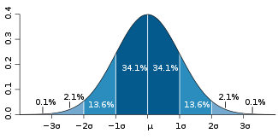
Normal Distributions
Central Tendency
The center of a frequency distribution
Standard deviation
Quantifies the amount of variation of a set of data values

Slide 17
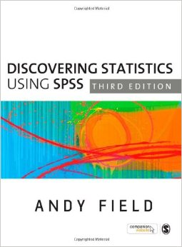
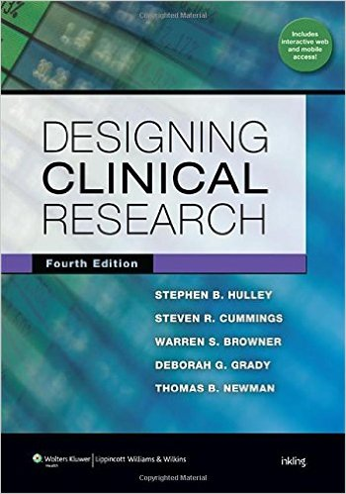
Supplemental Resources
Notes:
Field- great book on stats and how to use SPSS, easy to ready from analyses rel (also has a book on SAS) covers how you enter variables in to SPSS to growth models

Slide 18
Please complete evaluation forms prior to leaving- Thanks!

Slide 19
Session Schedule
All sessions held at the MVA from 12pm-1pm
Date | Topic
June 19 | Literature Reviews & Grants 101
June 26 | Writing a Scientific Manuscript (Part 1)
July 10 | Writing a Scientific Manuscript (Part 2)
July 17 | Fundamentals of Study Design
July 24 | Fundamentals of Biostatistics (Part 1)
July 31 | Fundamentals of Biostatistics (Part 2)
To RSVP call (615) 963-2820 or email mva@Meharry-Vanderbilt.org
Notes:
Powerpoint slides and supplemental resources will be loaded to the MVA website

