Slide 1
Principles of Research Writing & Design Educational Series Fundamentals of Study Design
Lauren Duke, MA
Program Coordinator
Meharry-Vanderbilt Alliance
17 July 2015
Notes:
If you have specific questions about your research, please wait until the end of the presentation.
Study Design goes in the methods section when writing a paper.

Slide 2
Session Outline
Research Question
Type of Study
Observational
Experimental
Quasi-experimental
Study Designs
Cross-sectional Studies
Cohort Studies
Case Control Studies
Randomized Controlled Trial (RCT)
Case-series
Case Report

Slide 3
What do you want to know?
Cause and effect? Prevalence? Incidence?
Example: What a child watches on television and violent behavior
Is this your first study with this population?
Is it feasible?
Money
Time
Rare outcomes
Infrastructure
How many participants do you have access to?
Notes:
How much money and time do you have?
Are you studying a rare disease?

Slide 4
What do you want to know?
Predictor vs. Outcome variables
Violent Behavior
Television Program
Notes:
Sex, age, and race will always be predictor variables because nothing in your study can influence them. Other variables can be interpreted as either predictor or outcome variables, and depends on the cause and effect hypothesis.

Slide 5
All Studies
Experimental
Observational
Randomized Control Trial
Non-randomized
Descriptive
Analytic
Quasi-experimental
Case reports
Cohort Study
Case series
Cross Sectional
Case-Control Study

Slide 6
Observational Analytic Study Designs

Slide 7
Cross Sectional Studies
Population
Sample
Exposed
Not Exposed
Developed disease
Developed disease
Did not develop disease
Did not develop disease
Can be used to examine
associations between two
or more variables
Prevalence
Notes:
All measurements are taken on a single occasion or within a short period of time.
This type of study measures prevalence: the proportion who have a disease or condition at one point in time.

Slide 8
Cross Sectional Studies
Serial Surveys
Using cross sectional studies in the same population over certain time intervals
Population
Sample
Sample
Sample
Exposed
Not Exposed
Exposed
Not Exposed
Exposed
Not exposed
Developed disease?
Developed disease?
Developed disease?
Developed disease?
Developed disease?
Developed disease?
Notes:
With Serial Surveys, you can see the prevalence of a disease, drug use, or other characteristic over time to show you changes: increases, decreases, leveled off results. This is not the same as a cohort study, because a new sample from the population is drawn each time.

Slide 9
Cohort Studies
Prospective cohort study begins here
Identify study subjects
Classify treatment status
Treatment of interest
Good outcome
Bad outcome
Prospective and Retrospective
Incidence
The proportion who
develop a disease or
condition over time.
Outcome has not yet
occurred
Retrospective cohort study begins here
Notes:
Estimates incidence: the proportion who develop a disease or condition over time.
Even diseases we think of as relatively common, such as breast cancer, happen at such a low rate in any given year that large numbers of people must be followed for long periods of time to observe enough outcomes to produce meaningful results.

Slide 10
Multiple-Cohort Studies
Two or more separate samples of subjects
One group with exposure to a potential risk factor, one without
Levels of exposure
Exposure
Control
Outcome
Outcome
Notes:
Different from a case control study because here the two groups are chosen based on the level of the predictor, not chosen based on the presence or absence of an outcome.

Slide 11
Design | Advantages | Disadvantages
Cross-sectional
 | - Short duration - Potential first step for a cohort study or clinical trial - Yields prevalence of multiple predictors and outcomes | - Does not establish sequence of events - Not feasible for rare predictors or rare outcomes - Does not yield incidence
Cohort Designs
All | - Sequence of events - Multiple predictors & outcomes - Number of outcomes grow over time - Yields incidence | - Often requires large sample sizes - Less feasible for rare outcomes - Attrition
Prospective | - More control over participant selection & measurements - Avoids bias in measuring predictors | - Follow-up can be lengthy - Often expensive
Retrospective | - Data collection complete - Relatively inexpensive | - Less control over participant selection & measurements
Multiple cohort | - Useful for distinct cohorts with different or rare exposures | - Bias and confounding from sampling distinct populations
Notes:
Cross sectional
Disadvantages: Does not establish a causal relationship. A factor that is associated with prevalence of a disease may be a cause of the disease but may also just be associated with duration of the disease.
It can also require a large sample size depending on what disease being is studied in the general population.
Prospective cohort:
Advantages
Prevents the predictor measures from being influenced by the outcome Because the outcome has not occurred yet
Disadvantages
Expensive
Inefficient for studying rare outcomes
Time-consuming
Even diseases we think of as relatively common, such as breast cancer, happen at such a low rate in any given year that large numbers of people must be followed for long periods of time to observe enough outcomes to produce meaningful results.
Retrospective cohort studies:
Advantages
Prevents the predictor measures from being influenced by the outcome
Relatively inexpensive and less time-consuming
Subjects are already assembled, baseline measurements have already been made, and the follow-up period has already taken place.
Disadvantages
Limited investigator control over sampling, follow-up, and quality of baseline measurements.
The existing data may be incomplete, inaccurate, or measured in ways that are not ideal for answering the research question.
Multiple cohort:
Advantages
May be the only feasible approach for studying rare exposures to potential occupational and environmental hazards.
Disadvantages
Confounding variables are accentuated

Slide 12
Case-Control Studies
“Working backwards”
or Retrospective
Effect studied first,
Cause second
Ex. Infant sleeping
position and SIDS

Slide 13
Case-Control Studies
Design | Advantages | Disadvantages
Case-Control
 | - Useful for rare outcomes - Short duration, small sample size - Relatively inexpensive | - Bias & confounding from sampling two populations - Limited to one outcome variable - Sequence of events may be unclear - Does not yield prevalence or incidence
Notes:
Case control
Advantages
Relatively inexpensive
Efficient for studying rare diseases
Disadvantages
Increased risk of bias
Only one outcome can be studied As opposed to cross sectional studies and cohort studies
A factor that is associated with prevalence of a disease may be a cause of the disease but may also just be associated with duration of the disease.
Depending on what disease is being studied in the general population.
Because you’re sampling backwards.
Infant sleeping position and SIDS

Slide 14
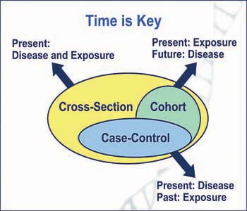

Slide 15
Observational Descriptive Study Designs

Slide 16
Case-series Studies
Descriptive, not analytic
Not hypothesis driven
Smaller sample size
Specific population
Tracks participants with known exposure, potentially based on similar treatment, and examines medical records for outcome.
Follow-up
Notes:
People who have a similar diagnosis are followed to see their outcome.

Slide 17
Case-Report Study
A detailed report of the of an individual patient
Symptoms
Signs
Diagnosis
Treatment
Follow-up
Treatment
Follow up
Symptoms
Diagnosis
Notes:
The difference between a case series is that this is just with an individual patient. Can have more than one case report.

Slide 18
Experimental Study Designs

Slide 19
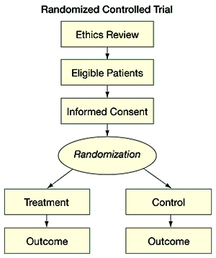
Randomized Clinical Trial (RCT)
Parallel, between-groups design
Can have more than two groups
Investigator assigns treatment
Random assignment
Participants are blind to group assignment
Double-blind studies
Gold Standard

Slide 20
Quasi-experimental Design
Target Population
Selection
Pre-test
Pre-test
Intervention
Post-test
Control
Post-test
Same as RCT, with no random assignment
Treatment with or without control group
Effect of a specific intervention on a specific population
Groups may already be defined
Investigators may designate cutoffs for treatment
vs. control
Pre-test Post-test design
Practice effects

Slide 21
All Studies
Experimental
Observational
Randomized Control Trial
Non-randomized
Descriptive
Analytic
Quasi-experimental
Case reports
Cohort Study
Case series
Cross Sectional
Case-Control Study

Slide 22
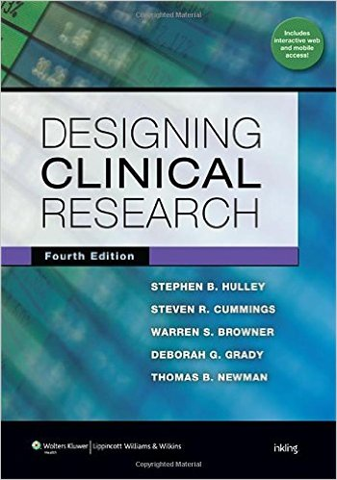
Supplemental Resources
Notes:
Field- great book on stats and how to use SPSS, easy to ready from analyses rel (also has a book on SAS) covers how you enter variables in to SPSS to growth models

Slide 23
Please complete evaluation forms prior to leaving- Thanks!

Slide 24
Session Schedule
All sessions held at the MVA from 12pm-1pm
Date | Topic
June 19 | Literature Reviews & Grants 101
June 26 | Writing a Scientific Manuscript (Part 1)
July 10 | Writing a Scientific Manuscript (Part 2)
July 17 | Fundamentals of Study Design
July 24 | Fundamentals of Biostatistics (Part 1)
July 31 | Fundamentals of Biostatics (Part 2)
To RSVP call (615) 963-2820 or email mva@Meharry-Vanderbilt.org
Notes:
Powerpoint slides and supplemental resources will be loaded to the MVA website

